Slide 1
Chapter 2 Network Models
2.1

Slide 2
2-1 LAYERED TASKS
We use the concept of layers in our daily life. As an example, let us consider two friends who communicate through postal mail. The process of sending a letter to a friend would be complex if there were no services available from the post office.
Topics discussed in this section: Sender, Receiver, and Carrier Hierarchy
2.2

Slide 3
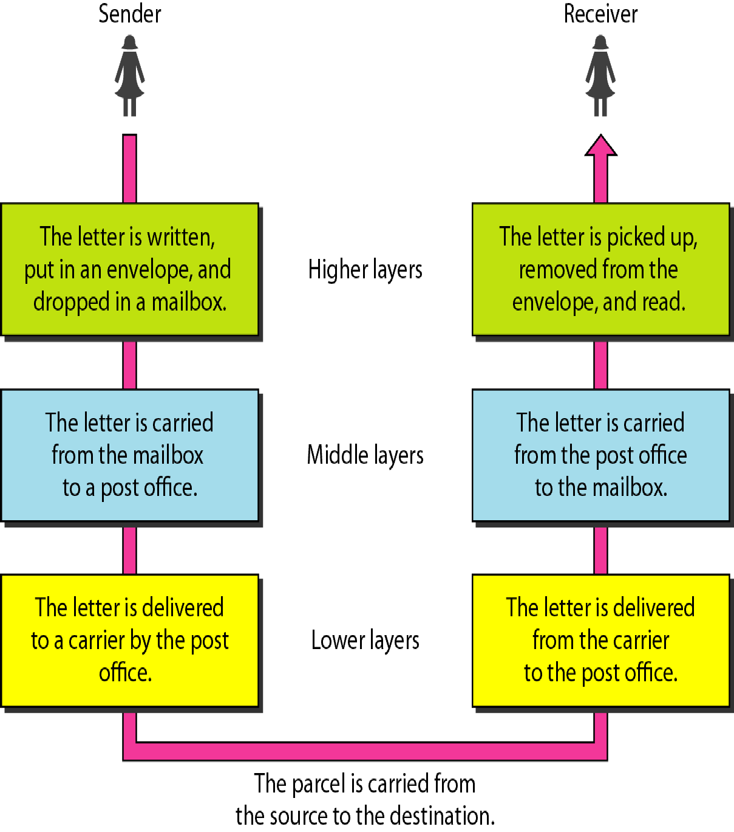
Figure 2.1 Tasks involved in sending a letter
2.3

Slide 4
2-2 THE OSI MODEL
Established in 1947, the International Standards Organization (ISO) is a multinational body dedicated to worldwide agreement on international standards. An ISO standard that covers all aspects of network communications is the Open Systems Interconnection (OSI) model.. It was first introduced in the late 1970s..
Topics discussed in this section:
Layered Architecture Peer-to-Peer Processes Encapsulation
2.4

Slide 5

Note
ISO is the organization.
OSI is the model.
2.5

Slide 6
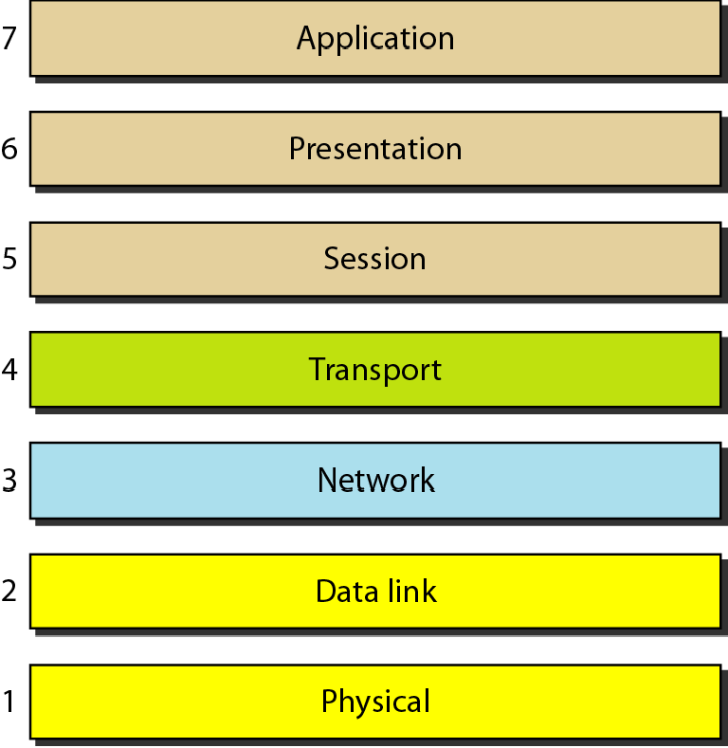
Figure 2.2 Seven layers of the OSI model
2.6

Slide 7
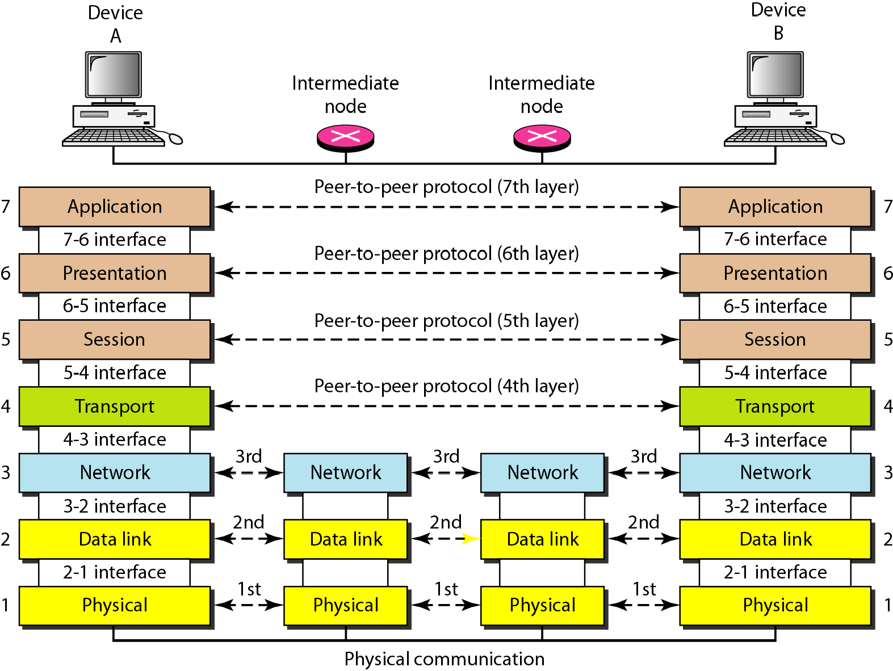
Figure 2.3 The interaction between layers in the OSI model
2.7

Slide 8
The interaction between layers in the OSI model
Peer-to-Peer Processes :
At the physical layer, communication is direct: The device A sends a stream of bits to device B (through intermediate nodes).
At the higher layers => communication must move down through the layers on device A, over to device B, and then back up through the layers.
Each layer in the sending device adds its own information to the message it receives from the layer just above it and passes the whole package to the layer just below it.
At layer 1 the entire package is converted to a form that can be transmitted to the receiving device.
At the receiving machine, the message is unwrapped layer by layer, with each process receiving and removing the data meant for it.
For example, layer 2 removes the data meant for it, then passes the rest to layer 3. Layer 3 then removes the data meant for it and passes the rest to layer 4, and so on.
2.8

Slide 9
The interaction between layers in the OSI model
Interfaces Between Layers:
The passing of the data and network information down through the layers of the sending device and back up through the layers of the receiving device is made possible by an interface between each pair of adjacent layers.
Each interface defines the information and services a layer must provide for the layer above it.
Well-defined interfaces and layer functions provide modularity to a network.
As long as a layer provides the expected services to the layer above it, the specific implementation of its functions can be modified or replaced without requiring changes to the surrounding layers.
2.9

Slide 10
The interaction between layers in the OSI model
Organization of the Layers:
The seven layers can be thought of as belonging to three subgroup
Layers I, 2, and 3-physical, data link, and network-are the network support layers; they deal with the physical aspects of moving data from one device to another (such as electrical specifications, physical connections, physical addressing, and transport timing and reliability)
Layers 5, 6, and 7-session, presentation, and application-can be thought of as the user support layers; they allow interoperability among unrelated software systems.
Layer 4, the transport layer, links the two subgroups and ensures that what the lower layers have transmitted is in a form that the upper layers can use.
The upper OSI layers are almost always implemented in software.
The lower layers are a combination of hardware and software, except for the physical layer, which is mostly hardware.
2.10

Slide 11
The interaction between layers in the OSI model
Organization of the Layers:
Figure 2.4, which gives an overall view of the OSI layers, D7 means the data unit at layer 7, D6 means the data unit at layer 6, and so on.
The process starts at layer 7 (the application layer), then moves from layer to layer in descending, sequential order.
At each layer, a header, or possibly a trailer, can be added to the data unit.
Commonly, the trailer is added only at layer 2.
When the formatted data unit passes through the physical layer (layer 1), it is changed into an electromagnetic signal and transported along a physical link.
2.11

Slide 12
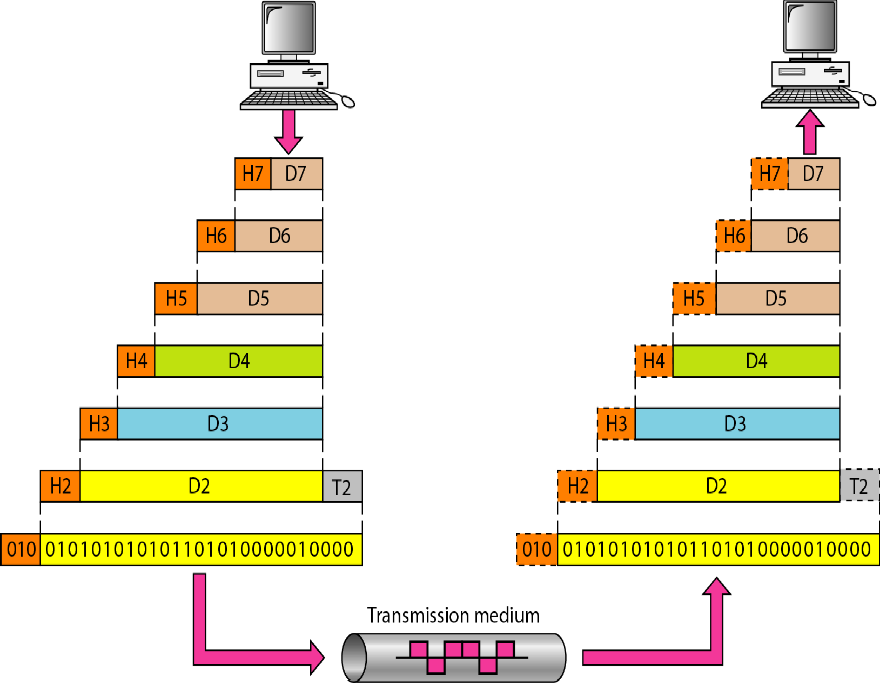
Figure 2.4 An exchange using the OSI model
2.12

Slide 13
Encapsulation
Figure 2.3 reveals another aspect of data communications in the OSI model: encapsulation.
A packet (header and data) at level 7 is encapsulated in a packet at level 6.
The whole packet at level 6 is encapsulated in a packet at level 5, and so on.
In other words, the data portion of a packet at level N - 1 carries the whole packet (data and header and maybe trailer) from level N.
The concept is called encapsulation; level N - 1 is not aware of which part of the encapsulated packet is data and which part is the header or trailer.
For level N - 1, the whole packet coming from level N is treated as one integral unit.
2.13

Slide 14
2-3 LAYERS IN THE OSI MODEL
In this section we briefly describe the functions of each layer in the OSI model..
Topics discussed in this section:
Physical Layer Data Link Layer Network Layer Transport Layer Session Layer Presentation Layer Application Layer
2.14

Slide 15
The physical layer is responsible for movements of individual bits from one hop (node) to the next.

Slide 16
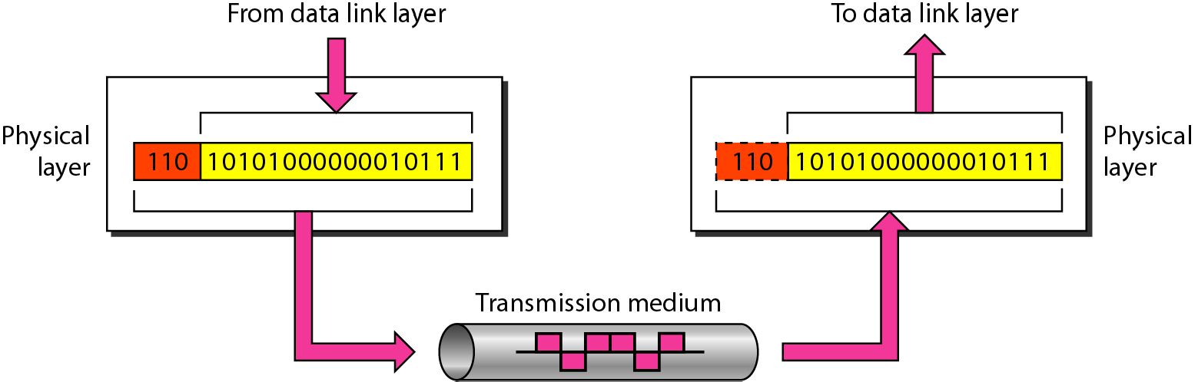
Figure 2.5 Physical layer

Slide 17
Figure 2.5 Physical layer
The physical layer is also concerned with the following:
Physical characteristics of interfaces and medium
Representation of bits
Data rate
Synchronization of bits
Line configuration
Physical topology
Transmission mode

Slide 18
The data link layer is responsible for moving frames from one hop (node) to the next.

Slide 19
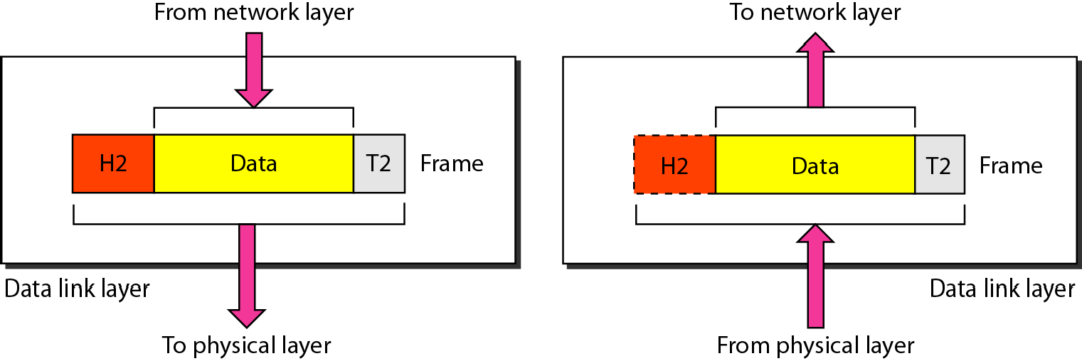
Figure 2.6 Data link layer

Slide 20
Figure 2.6 Data link layer
Other responsibilities of the data link layer include the following:
Framing
Physical addressing
Flow control
Error control
Access control

Slide 21
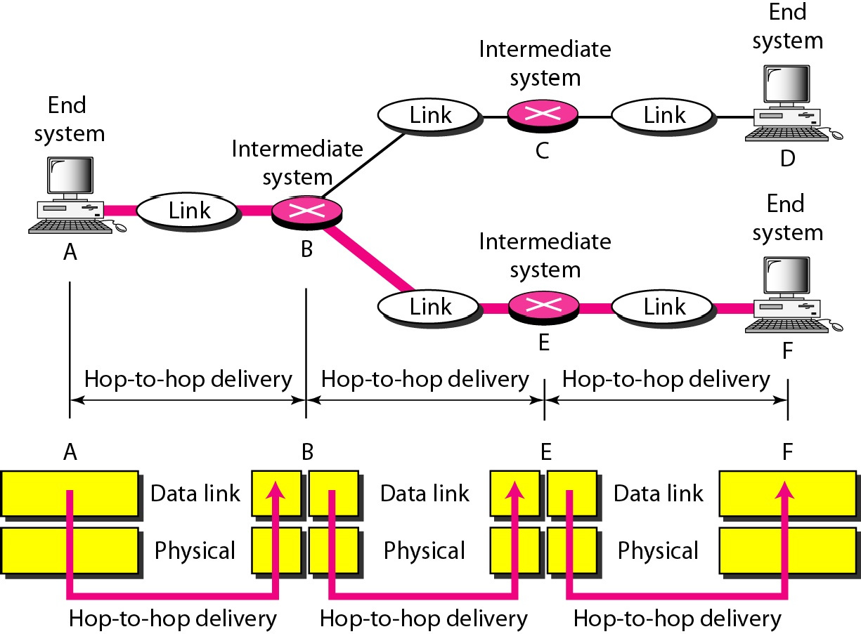
Figure 2.7 Hop-to-hop delivery

Slide 22
The network layer is responsible for the delivery of individual packets from
the source host to the destination host.

Slide 23
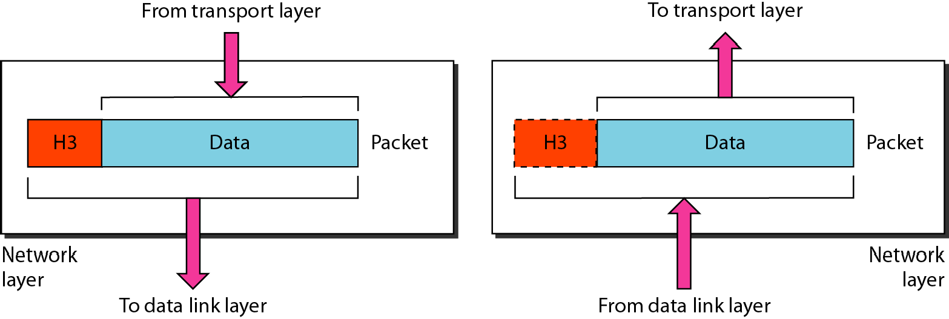
Figure 2.8 Network layer

Slide 24
Figure 2.8 Network layer
Other responsibilities of the network layer include the following:
Logical addressing
Routing

Slide 25
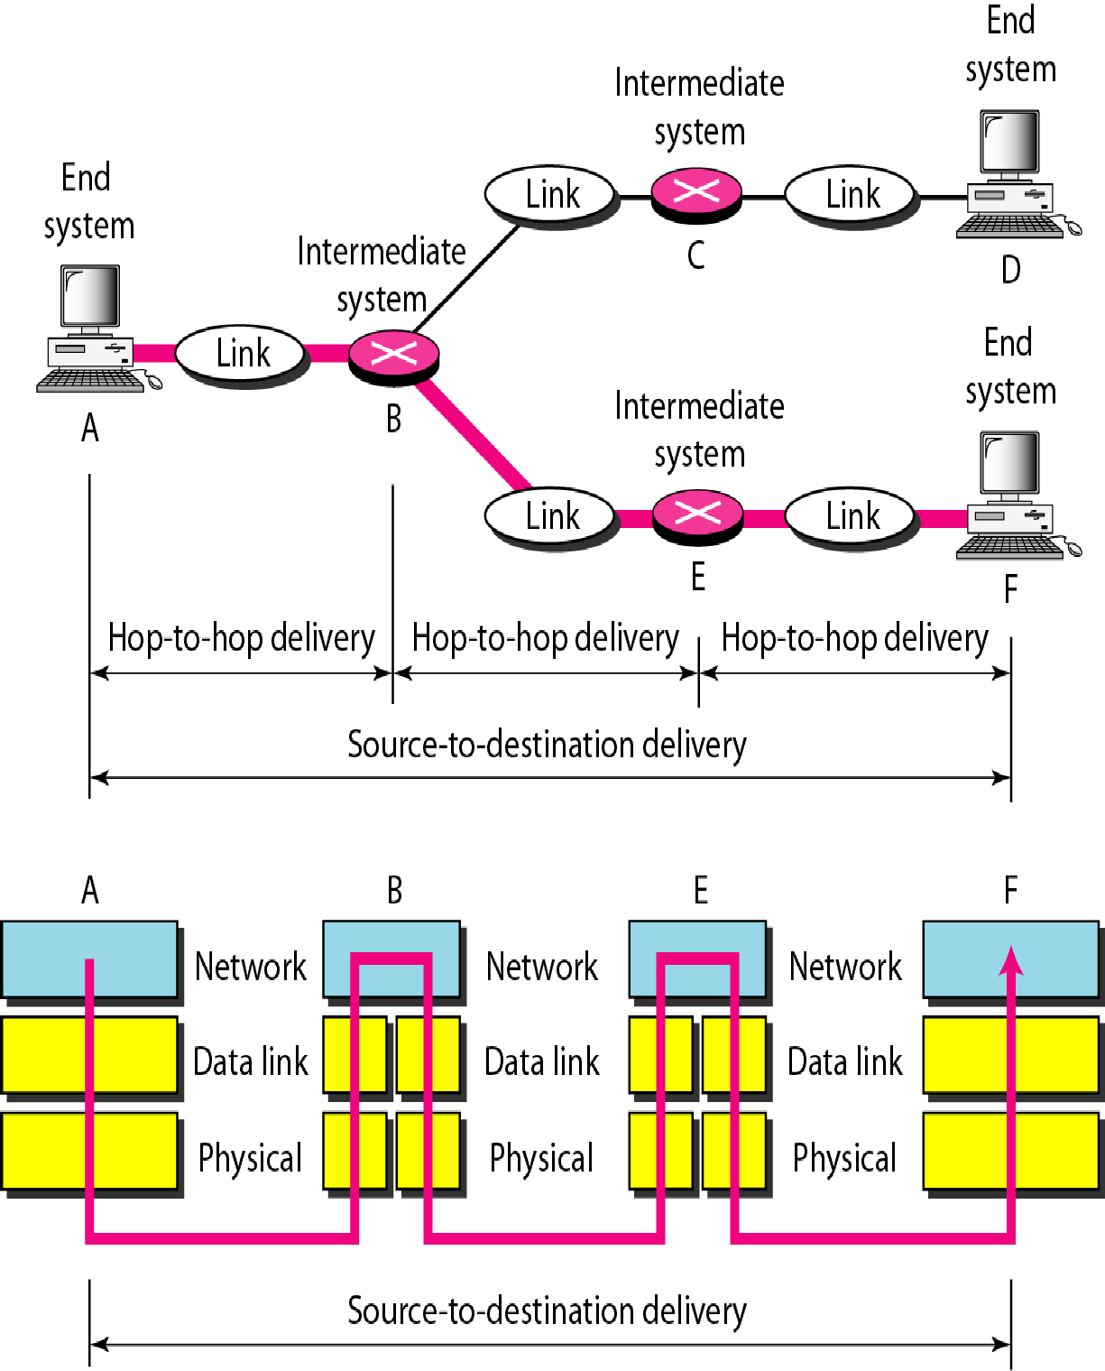
Figure 2.9 Source-to-destination delivery

Slide 26
The transport layer is responsible for the delivery of a message from one process to another.

Slide 27
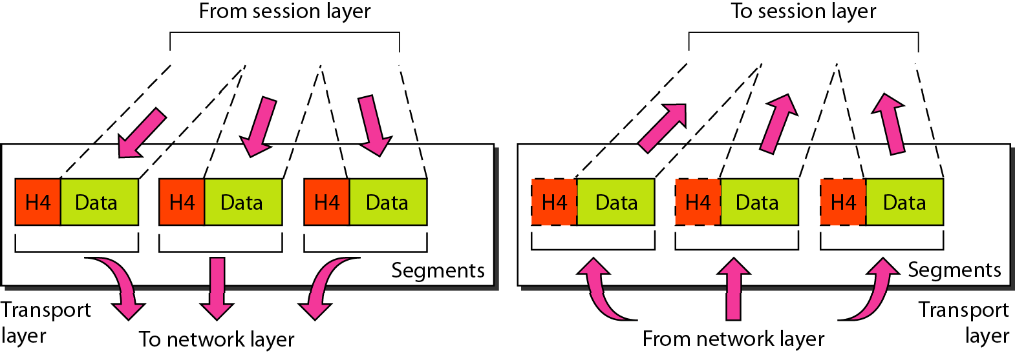
Figure 2.10 Transport layer

Slide 28
Figure 2.10 Transport layer
Other responsibilities of the transport layer include the following:
Service-point addressing
Segmentation and reassembly
Connection control
Flow control
Error control

Slide 29
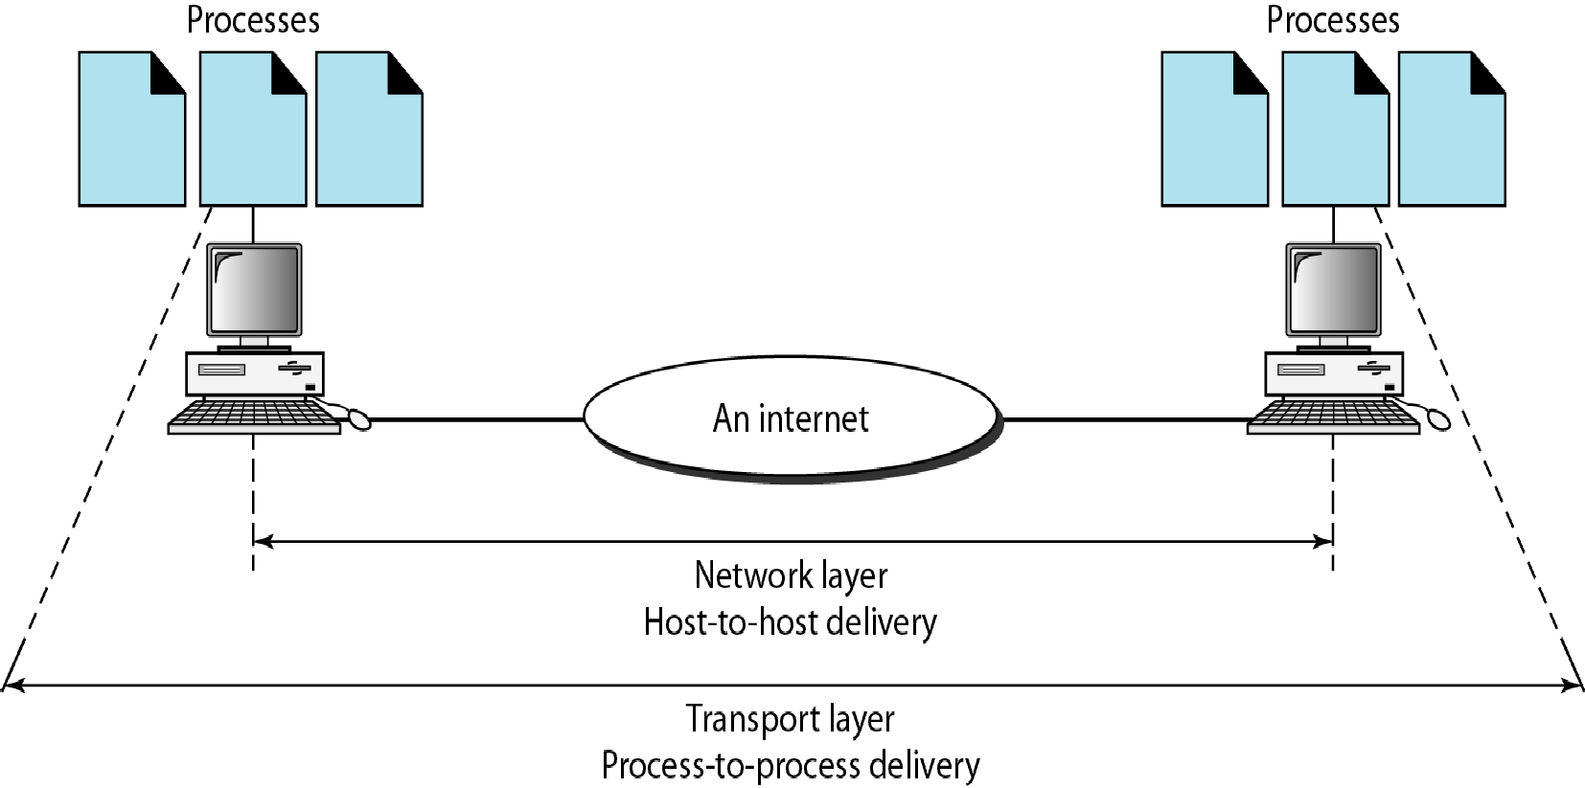
Figure 2.11 Reliable process-to-process delivery of a message

Slide 30
The session layer is responsible for dialog control and synchronization.

Slide 31
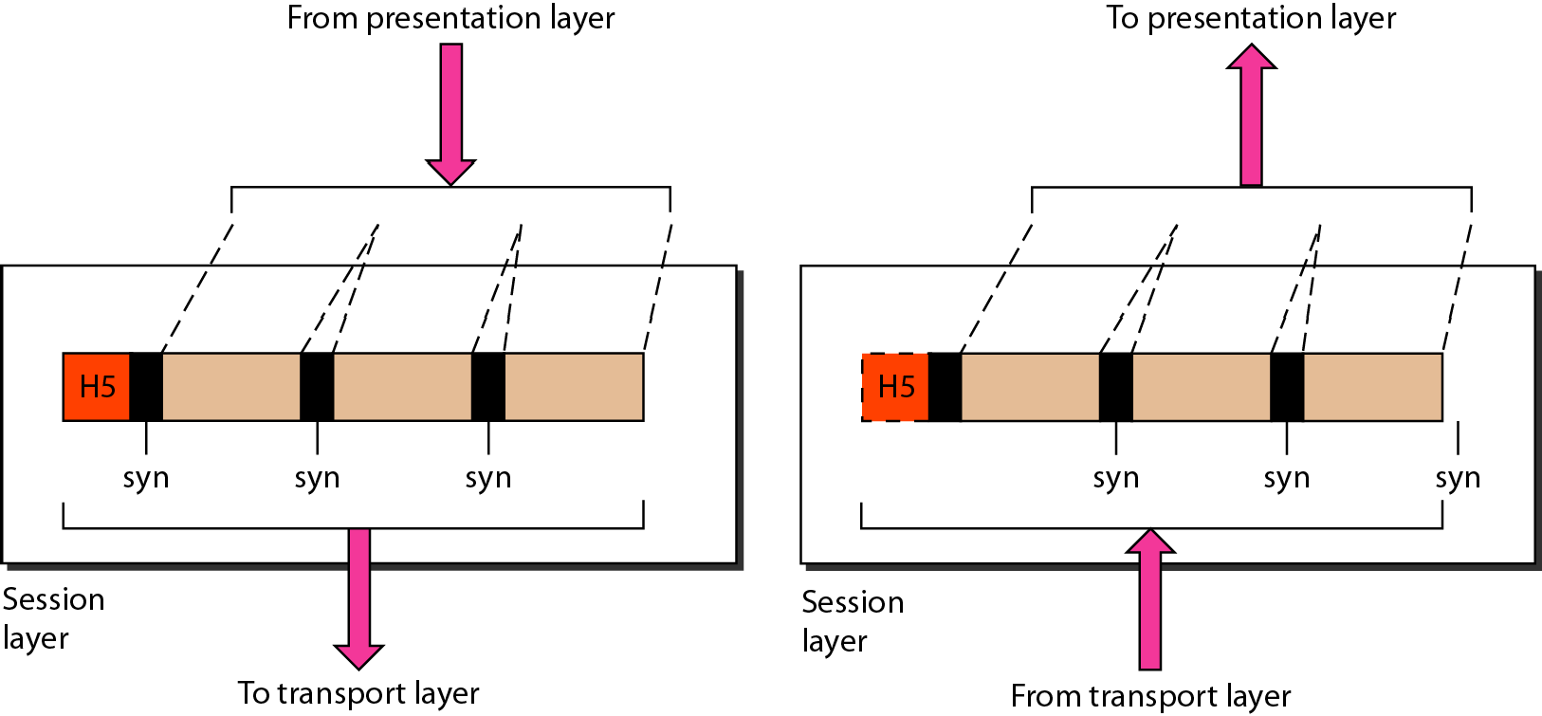
Figure 2.12 Session layer

Slide 32
Figure 2.12 Session layer
Specific responsibilities of the session layer include the following:
Dialog control
Synchronization

Slide 33
The presentation layer is responsible for translation, compression, and encryption.

Slide 34
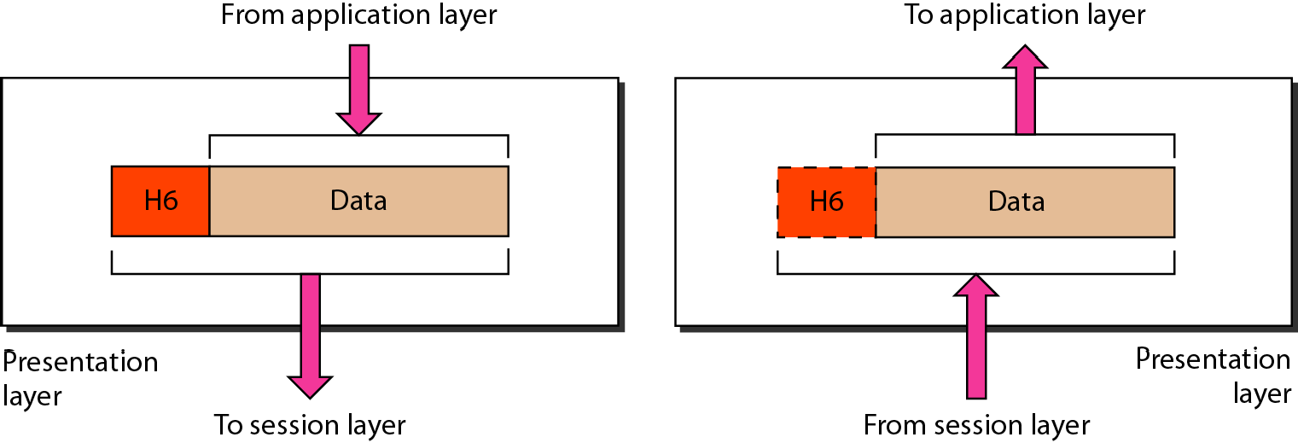
Figure 2.13 Presentation layer

Slide 35
Figure 2.13 Presentation layer
Specific responsibilities of the presentation layer include the following:
Translation
Encryption
Compression

Slide 36
Note
The application layer is responsible for providing services to the user.

Slide 37
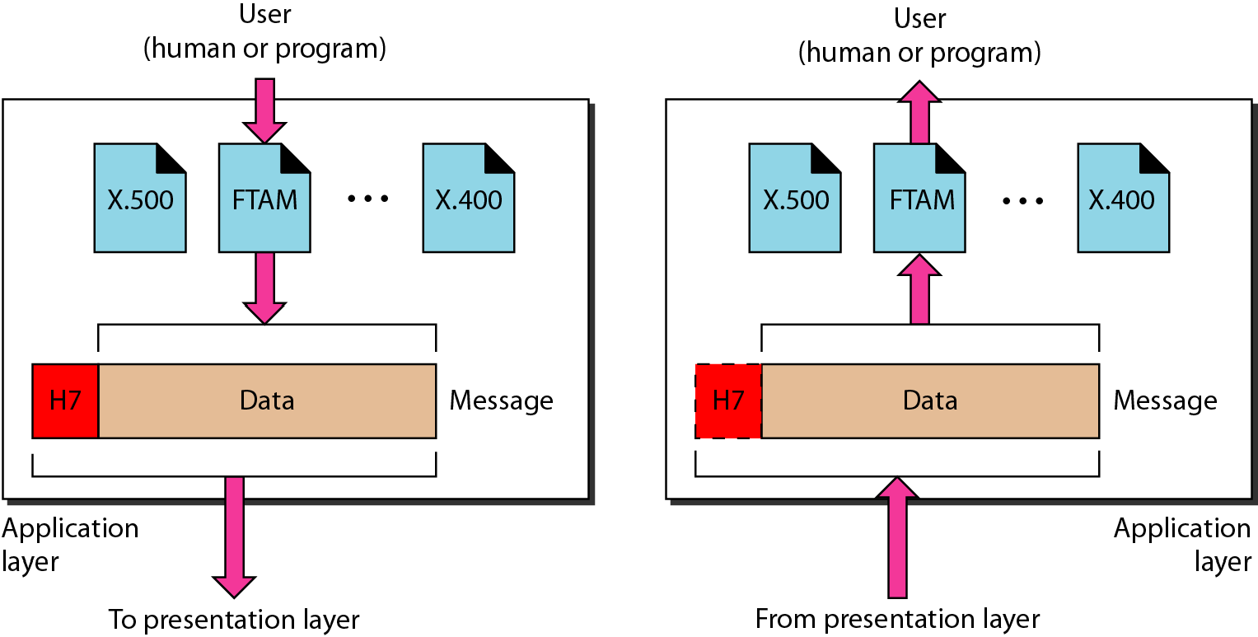
Figure 2.14 Application layer

Slide 38
Figure 2.14 Application layer
Specific services provided by the application layer include the following:
Network virtual terminal
File transfer, access, and management
Mail services
Directory services

Slide 39
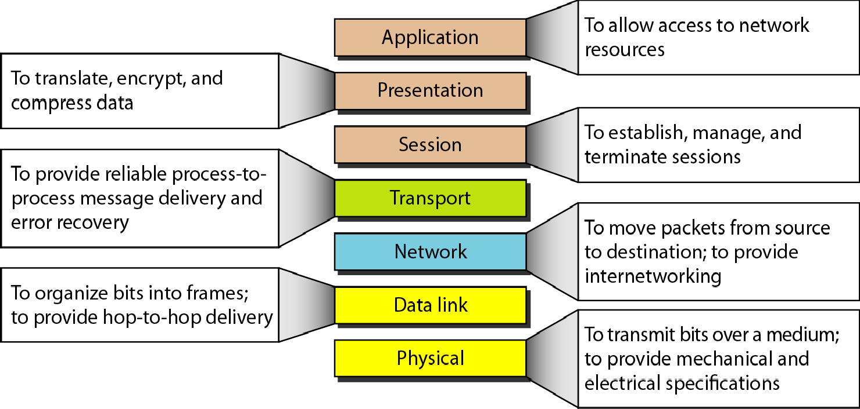
Figure 2.15 Summary of layers

Slide 40
2-4 TCP/IP PROTOCOL SUITE
The layers in the TCP/IP protocol suite do not exactly match those in the OSI model.. The original TCP/IP protocol suite was defined as having four layers: host-to- network,, internet,, transport,, and application.. However, when TCP/IP is compared to OSI, we can say that the TCP/IP protocol suite is made of five layers: physical,, data link,, network,, transport,, and application..
Topics discussed in this section: Physical and Data Link Layers Network Layer
Transport Layer Application Layer

Slide 41
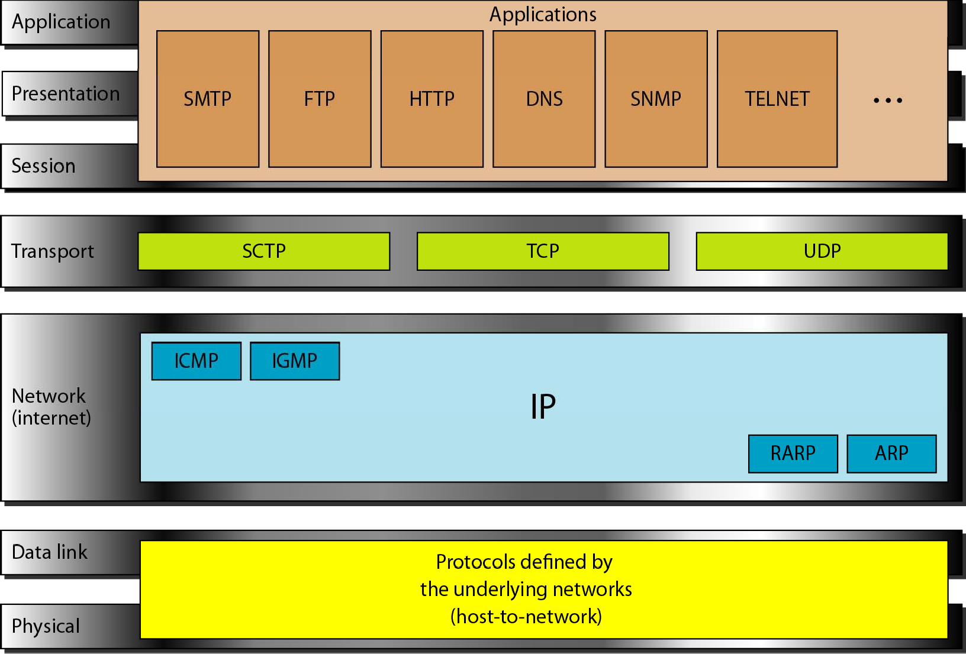
Figure 2.16 TCP/IP and OSI model

Slide 42
Figure 2.16 TCP/IP and OSI model
Physical and Data Link Layers:
At the physical and data link layers, TCP/IP does not define any specific protocol. It supports all the standard and proprietary protocols. A network in a TCP/IP internetwork
can be a local-area network or a wide-area network.
Network Layer:
At the network layer (or, more accurately, the internetwork layer), TCP/IP supports the Internetworking Protocol. IP, in turn, uses four supporting protocols: ARP, RARP, ICMP, and IGMP.

Slide 43
Figure 2.16 TCP/IP and OSI model
Internetworking Protocol (IP) : It is an unreliable and connectionless protocol-a best-effort delivery service.
Address Resolution Protocol (ARP): ARP is used to find the physical address of the node when its Internet address is known.
Reverse Address Resolution Protocol (RARP): allows a host to discover its Internet address when it knows only its physical address.
Internet Control Message Protocol (ICMP) : sends query and error reporting messages(host or gateway).
Internet Group Message Protocol (IGMP): is used to facilitate the simultaneous transmission of a message to a group of recipients.

Slide 44
Figure 2.16 TCP/IP and OSI model
Transport Layer:
The transport layer was represented in TCP/IP by two protocols: TCP and UDP.
IP is a host-to-host protocol, meaning that it can deliver a packet from one physical device to another.
UDP and TCP are transport level protocols responsible for delivery of a message from a process (running program) to another process.
A new transport layer protocol, SCTP, has been devised to meet the needs of some newer applications.

Slide 45
Figure 2.16 TCP/IP and OSI model
User Datagram Protocol (UDP): It is a process-to-process protocol that adds only port addresses, checksum error control, and length information to the data from the upper layer.
Transmission Control Protocol (TCP): provides full transport-layer services to applications. TCP is a reliable stream transport protocol. The term stream means connection-oriented. A connection must be established between both ends of a transmission before either can transmit data.
Stream Control Transmission Protocol (SCTP): provides support for newer applications such as voice over the Internet. It is a transport layer protocol that combines the best features of UDP and TCP.

Slide 46
Figure 2.16 TCP/IP and OSI model
Application Layer:
The application layer in TCPI/IP is equivalent to the combined session, presentation, and application layers in the OSI model. Many protocols are defined at this layer.

Slide 47
2-5 ADDRESSING
Four levels of addresses are used in an internet employing the TCP/IP protocols: physical, logical, port, and specific addresses
Topics discussed in this section:
Physical Addresses Logical Addresses Port Addresses Specific Addresses

Slide 48
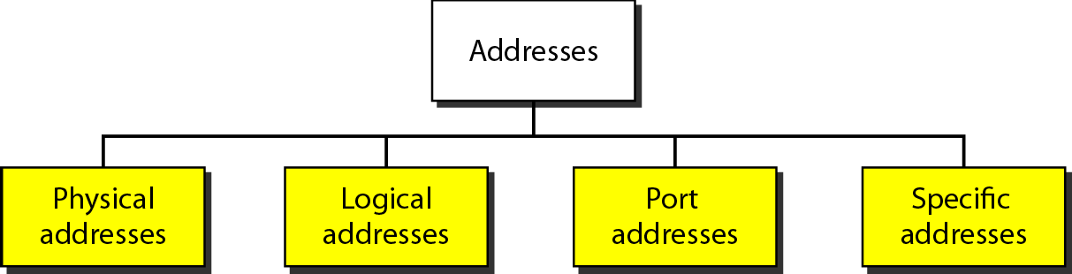
Figure 2.17 Addresses in TCP/IP

Slide 49
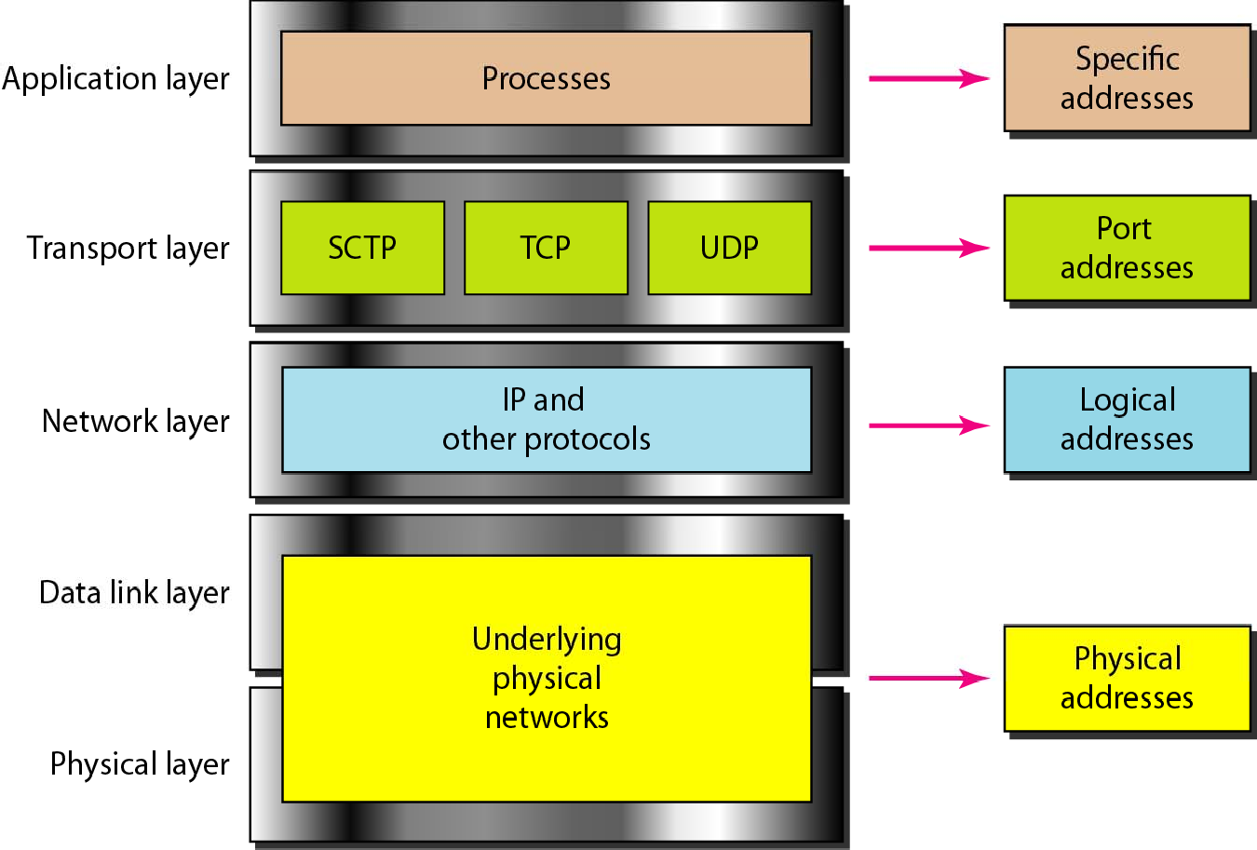
Figure 2.18 Relationship of layers and addresses in TCP/IP

Slide 50
Physical Addresses
The physical address, also known as the link address, is the address of a node as defined by its LAN or WAN.
It is included in the frame used by the data link layer.
It is the lowest-level address.
The physical addresses have authority over the network (LAN or WAN).
The size and format of these addresses vary depending on the network.
For example: Ethernet uses a 6-byte (48-bit) physical address that is imprinted on the network interface card (NIC).
LocalTalk (Apple), however, has a 1-byte dynamic address that changes each time the station comes up.

Slide 51

Example 2.1
In Figure 2.19 a node with physical address 10 sends a frame to a node with physical address 87. The two nodes are connected by a link (bus topology LAN) As the figure shows, the computer with physical address 10 is the sender, and the computer with physical address 87 is the receiver.

Slide 52
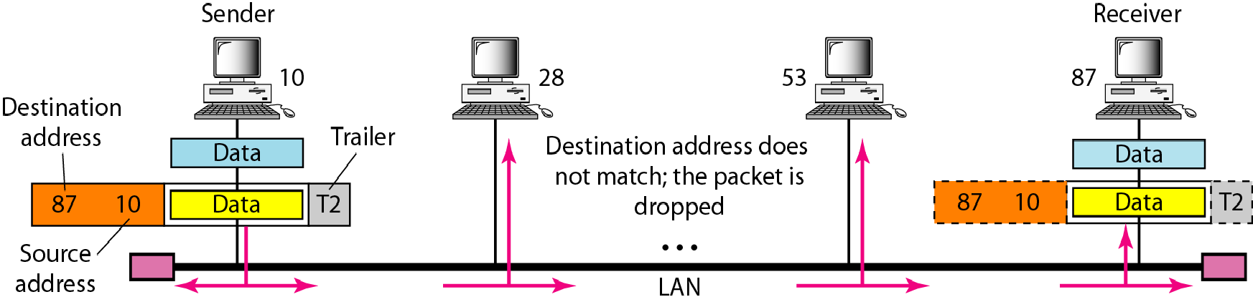
Figure 2.19 Physical addresses

Slide 53
Example 2.2
The most of the local-area networks use a 48-bit (6-byte) physical address written as 12 hexadecimal digits; every byte (2 hexadecimal digits) is separated by a colon, as shown below:
07:01:02:01:2C:4B
A 6-byte (12 hexadecimal digits) physical address.

Slide 54
Example 2.3
Figure 2.20 shows a part of an internet with two routers connecting three LANs. Each device (computer or router) has a pair of addresses (logical and physical) for each connection. In this case, each computer is connected to only one link and therefore has only one pair of addresses. Each router, however, is connected to three networks (only two are shown in the figure). So each router has three pairs of addresses, one for each connection.

Slide 55
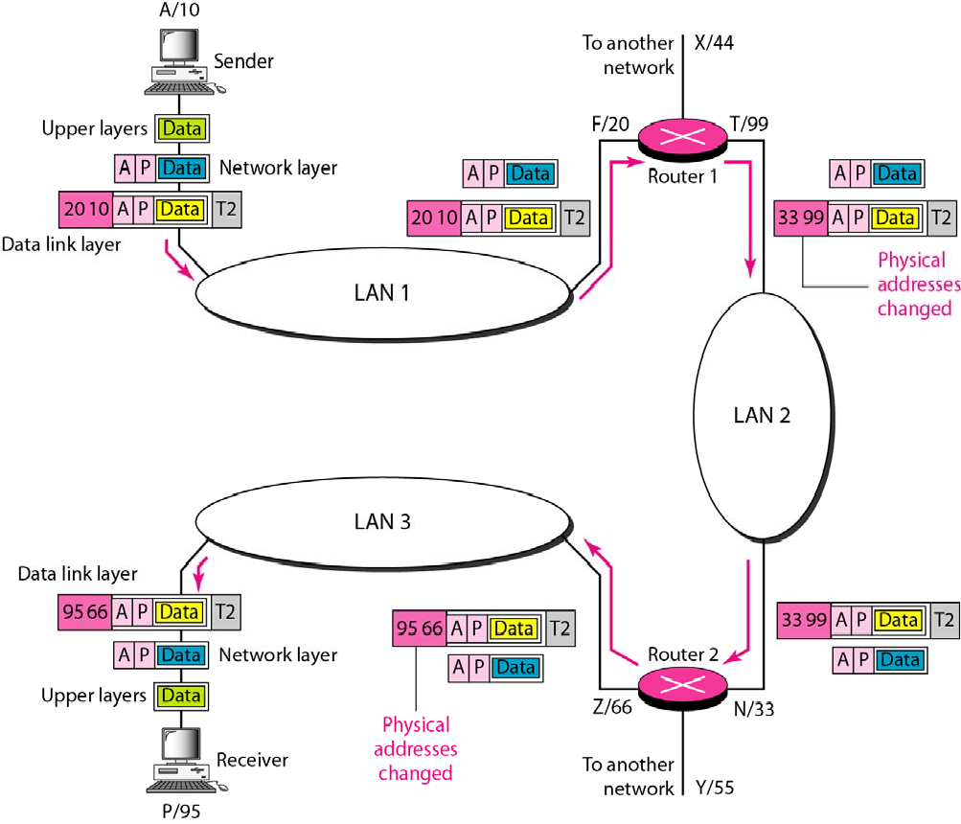
Figure 2.20 IP addresses

Slide 56
Example 2.4
Figure 2.21 shows two computers communicating via the Internet. The sending computer is running three processes at this time with port addresses a, b, and c. The receiving computer is running two processes at this time with port addresses j and k. Process a in the sending computer needs to communicate with process j in the receiving computer. Note that although physical addresses change from hop to hop, logical and port addresses remain the same from the source to destination.

Slide 57
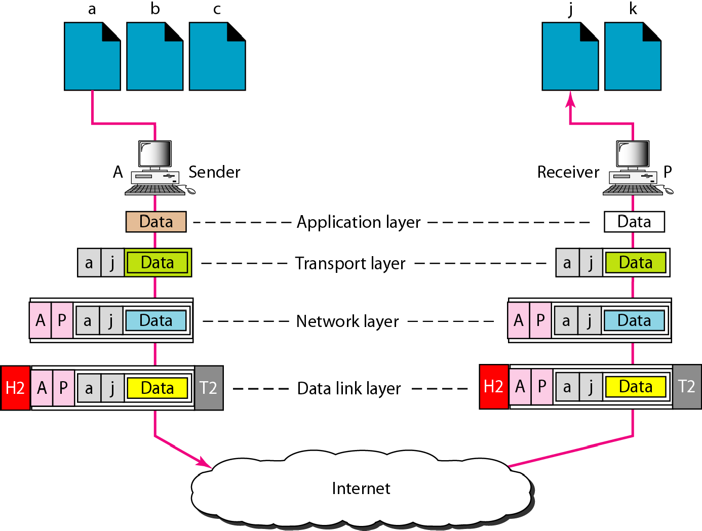
Figure 2.21 Port addresses
Figure 2.21 shows two computers communicating via the Internet. The sending computer is running three processes at this time with port addresses a, b, and c. The receiving computer is running two processes at this time with port addresses j and k. Process a in the sending computer needs to communicate with process j in the receiving computer. Note that although physical addresses change from hop to hop, logical and port addresses remain the same from the source to destination

Slide 58
Note
The physical addresses will change from hop to hop, but the logical addresses usually remain the same.

Slide 59
Example 2.5
A port address is a 16-bit address represented by one decimal number as shown.
753
A 16-bit port address represented as one single number.

Slide 60
Note
The physical addresses change from hop to hop,
but the logical and port addresses usually remain the same.

